Slide 1
CLASS 6
Computer Vision

Slide 2
Convnets - Primary Element of CV using Deep Learning
Convnets: Models built using Convolution Layers
Convolution: A mathematical concept which involved CONVOLVING of one matrix with an other matrix. (also applicable to Tensors.)
Why CONVNETS As we have seen in minist dataset, there were 784 features in the input layer. Imagin if an image is 225 x 225 x 3, it would equate to 151,875.
Again imagin the number of weights if the model contains only one hidden layer of 1024 size ... makies whooping 155.5 Million parameters in just a single hidden layerd model.
--Thats too much for computer resources, while the model would not be able to do something appreceable.
So Convnets came to rescue and paved the way for success of Deep Learning starting off with 2013-2015 ILSCVR competitions.

Slide 3
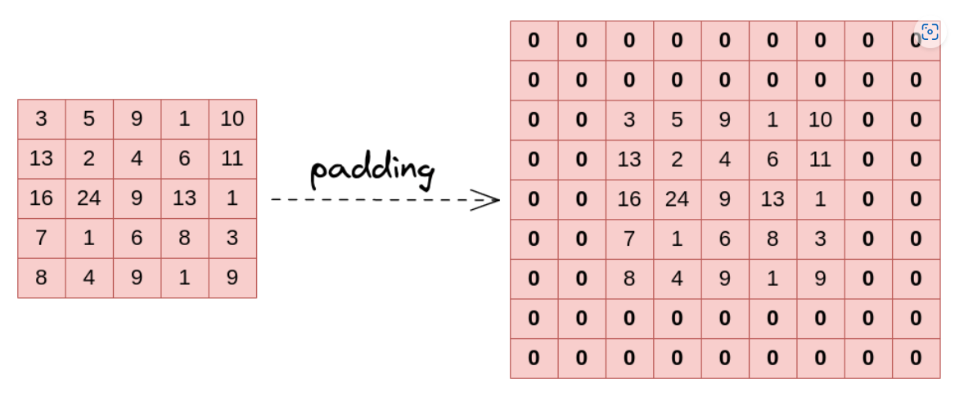
Padding

Slide 4
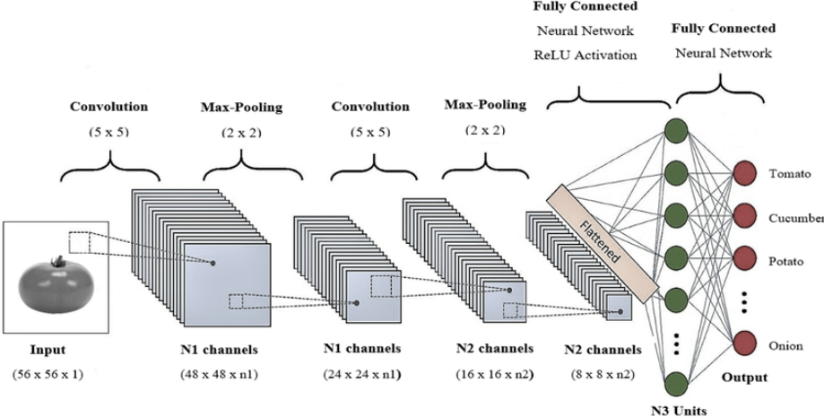
Convnet

Slide 5
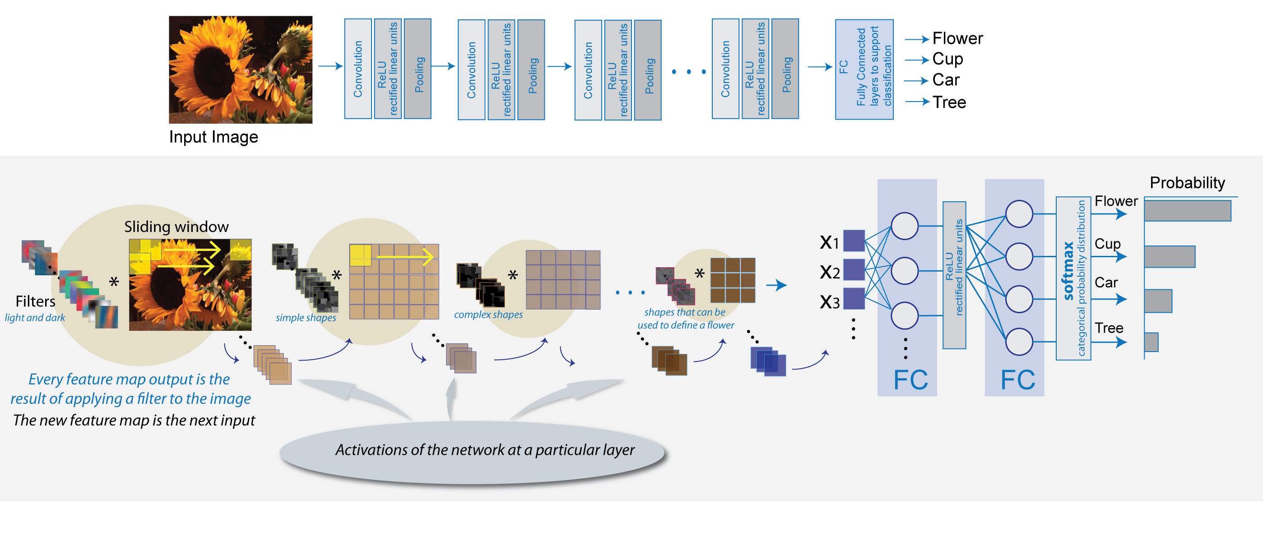

Slide 6
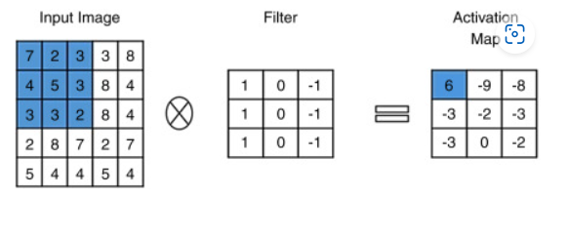
Concept of Convolution Filters
code
7*1 + 2*0 + 3*-1 =4
4*1 + 5*0 + 3*-1= 1 sum al 3 rows=6
3*1 + 3*0 + 2*-1 = 1

Slide 7
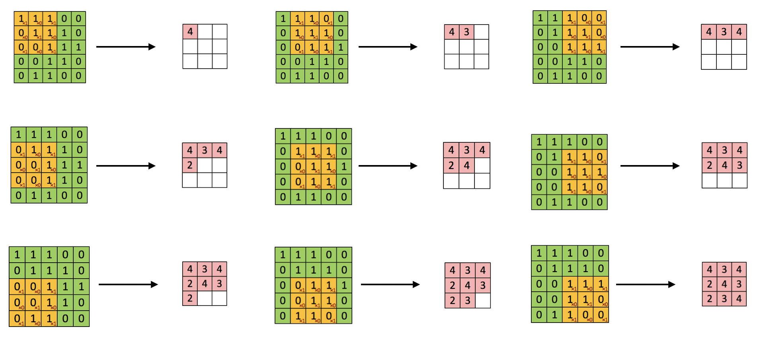

Slide 8
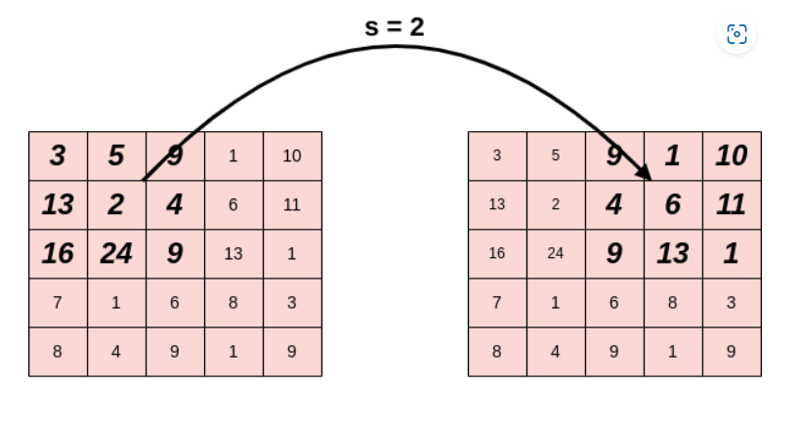
Strides

Slide 9
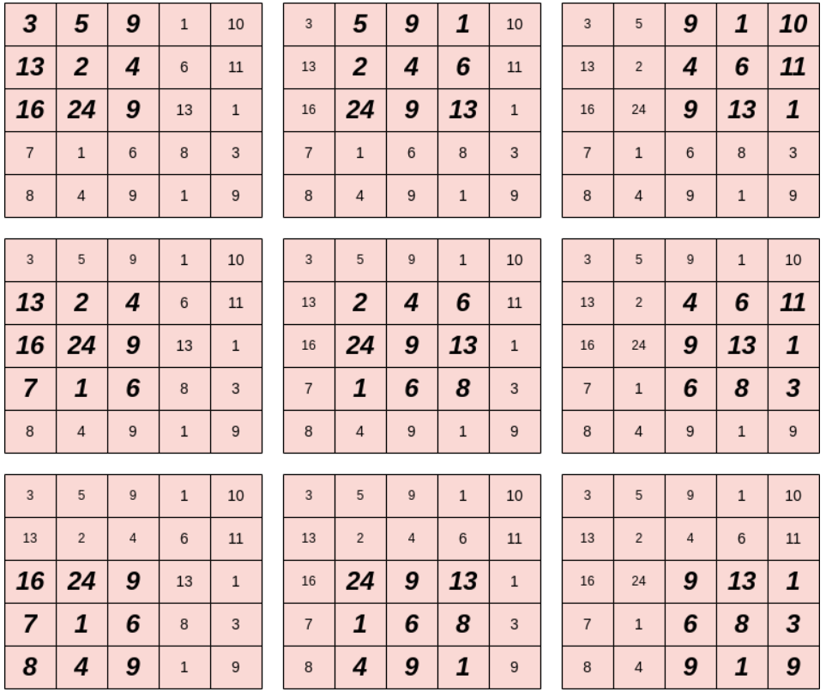
Source Image Successive Patches

Slide 10
CONVOLUTION

